Slide 1
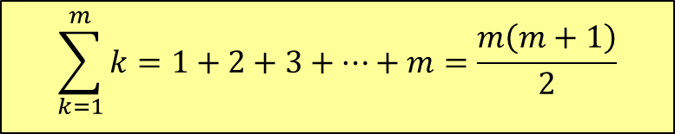
Time Complexity
Arithmetic series:
$$\sum_{k=1}^{m}{k=1+2+3+…+m=\frac{m\left(m+1\right)}{2}}$$

Slide 2
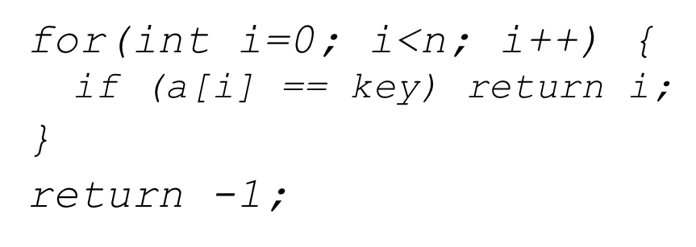
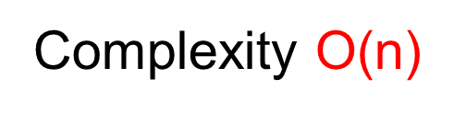
Program Analysis: Today
Static code
analysis
T(n) = n + 1
Big-O estimate
Big-O
proof
T(n) = O(n)

Slide 3
Ideal Solution
Express running time as a function of the input size n (i.e., f(n)).
Compare different functions corresponding to running times.
Such an analysis is independent of machine time, programming style, etc.
Always think in the long run: n → +∞

Slide 4
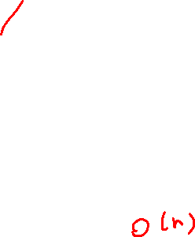
Worst Case - BigO
Provides an upper bound on running time
[Upper bound] : An absolute guarantee that the algorithm would not run longer, no matter what the inputs are
“Finding max element in an array A[ n ]; will NOT take more than (3n+8).”

Slide 5
Best Case – Big Ω
Provides a lower bound on running time
Input is the one for which the algorithm runs the fastest
“Finding out a key in an array A[ n ]; will take 1 unit time in the best case.”

Slide 6
Average Case – Big θ
Provides a prediction about the running time
Assumes that the input is random

Slide 7
Asymptotic Analysis
To compare two algorithms with running times f(n) and g(n), we need a rough measure that characterizes how fast each function grows.
Hint: use rate of growth
Compare functions in the limit, that is, asymptotically!
(i.e., for large values of n)

Slide 8
Rate of Growth
Consider the example of buying elephants and goldfish:
Cost: cost_of_elephants + cost_of_goldfish
Cost ~ cost_of_elephants (approximation)
The low order terms in a function are relatively insignificant for large n
n⁴ + 100n² + 10n + 50 ~ n⁴
i.e., we say that n⁴ + 100n² + 10n + 50 and n⁴ have the same rate of growth

Slide 9
Asymptotic Notation
O notation: asymptotic “less than”: (Worst Case) f(n)=O(g(n)) implies: f(n) “≤” g(n)
Ω notation: asymptotic “greater than”: (Best Case) f(n)= Ω (g(n)) implies: f(n) “≥” g(n)
Θ notation: asymptotic “equality”: (Average)
f(n)= Θ (g(n)) implies: f(n) “=” g(n)

Slide 10
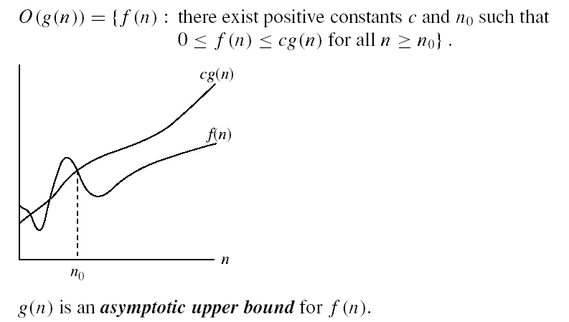
O – Notation
O(g(n)) is the set of functions with smaller or same order of growth as g(n)

Slide 11
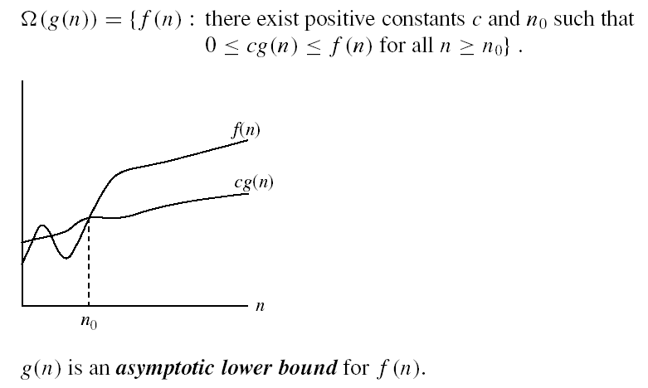
Ω – Notation
Ω(g(n)) is the set of functions with larger or same order of growth as g(n)

Slide 12
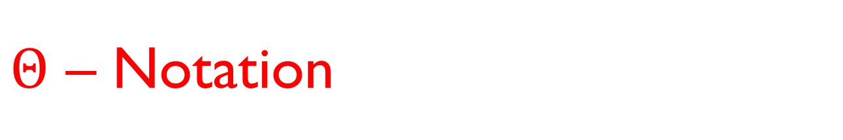

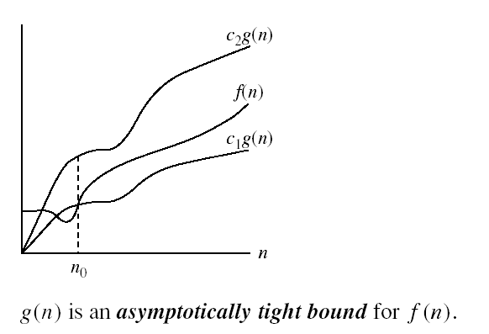
$Θ$ – Notation
Θ(g(n)) is the set of functions with the same order of growth as g(n)

Slide 13







Why Asymptotic Notations?
Short:$O\left(\log{n}\right),O\left(\sqrt{n}\right),O\left(n\right),O(n\log{n}), O(n^{2})$
Easy to recognize, compare and classify
$$O(n^{2})$$
$$O(n\log{n})$$
$$O\left(n\right)$$
$$O\left(n^{ε}\right)$$
$$O\left(\log{n}\right)$$
$$O(1)$$

Slide 14
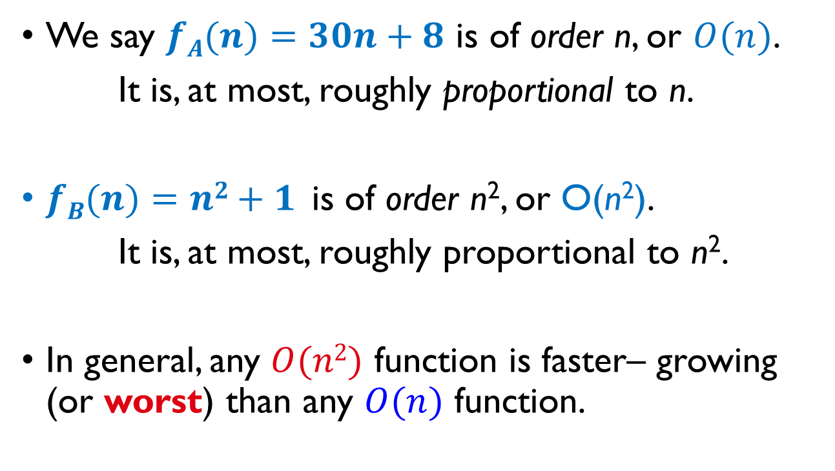
Big-O Notation
We say $fA(n)=30n+8$ is of order n, or $O(n)$.
It is, at most, roughly proportional to n.
$fB(n)=n2+1$ is of order n², or O(n²).
It is, at most, roughly proportional to n².
In general, any $O(n2)$ function is faster– growing (or worst) than any $O(n)$ function.

Slide 15
Big-O Notation
In general, big-O of a polynomial is the leading term without its coefficient
n⁴ + 100n² + 10n + 50 is O(n⁴)
10n³ + 2n² is O(n³)
n³ - n² is O(n³)
Constants
10 is O(1)
1273 is O(1)

Slide 16
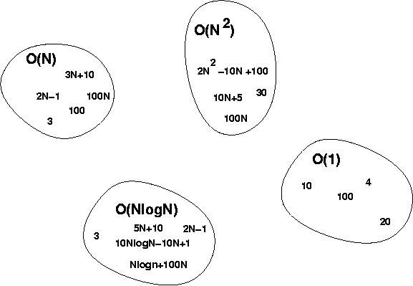
Big-O Visualization

Slide 17
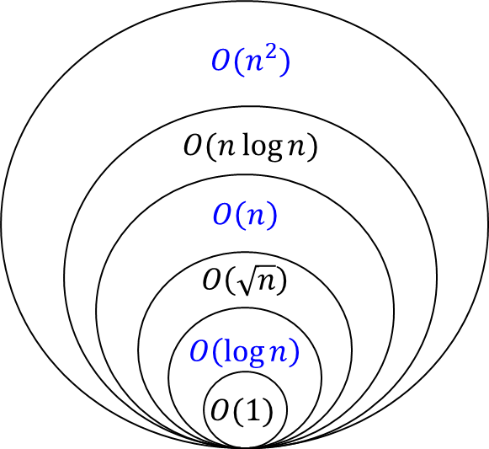
Big-O Visualization

Slide 18
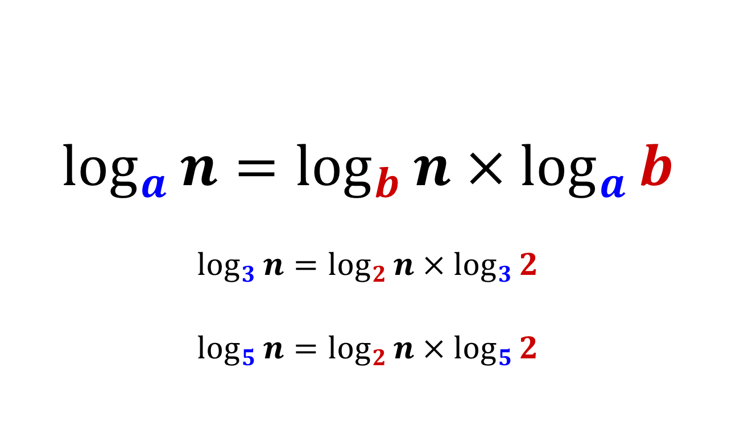

Note: $\log{n}$ in different bases
$$\log_{a}{n}=\log_{b}{n}×\log_{a}{b}$$
$$\log_{3}{n}=\log_{2}{n}×\log_{3}{2}$$
$$\log_{5}{n}=\log_{2}{n}×\log_{5}{2}$$

Slide 19
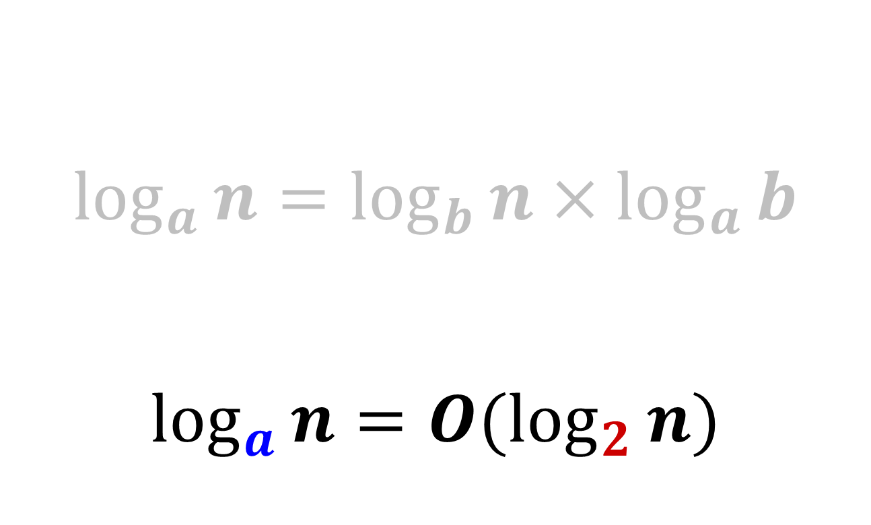
Note: $\log{n}$ in different bases
$$\log_{a}{n}=\log_{b}{n}×\log_{a}{b}$$
$$\log_{a}{n}=O(\log_{2}{n)}$$

Slide 20
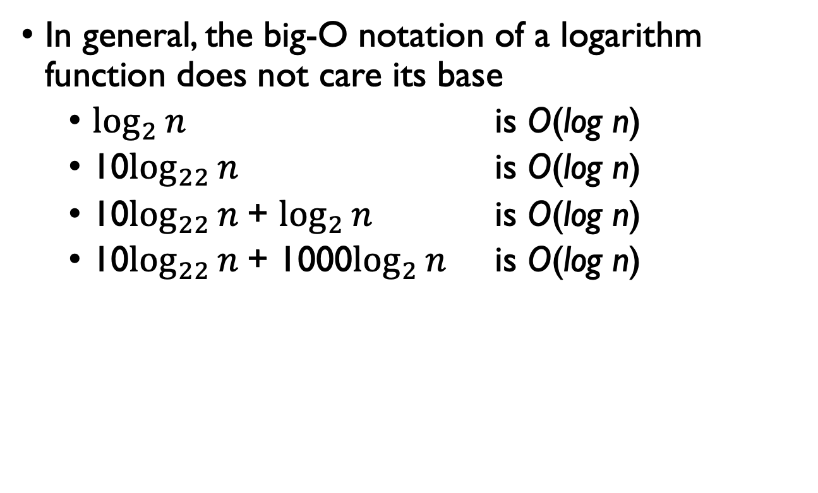
Big-O Notation
In general, the big-O notation of a logarithm function does not care its base
$\log_{2}{n}$ is O(log n)
10$\log_{22}{n}$ is O(log n)
10$\log_{22}{n}$+ $\log_{2}{n}$ is O(log n)
10$\log_{22}{n}$+ 1000$\log_{2}{n}$ is O(log n)

Slide 21
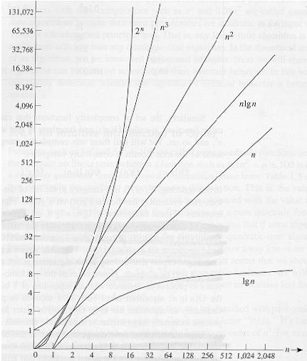
Common orders of magnitude

Slide 22
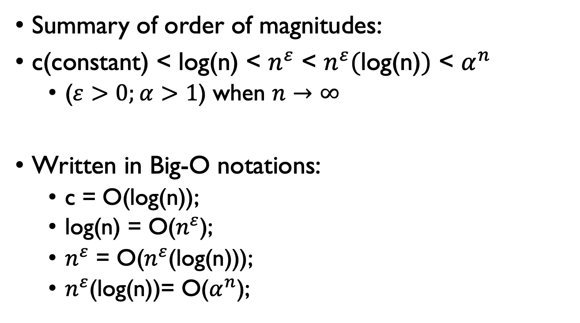
Common orders of magnitude
Summary of order of magnitudes:
c(constant) < log(n) < $n^{ε}$ < $n^{ε}(\text{log}\text{(}\text{n}\text{)})$ < $α^{n}$
($ε>0;α>1$) when $n→∞$
Written in Big-O notations:
c = O(log(n));
log(n) = O($n^{ε}$);
$n^{ε}$ = O($n^{ε}$(log(n)));
$n^{ε}$(log(n))= O($α^{n}$);

Slide 23
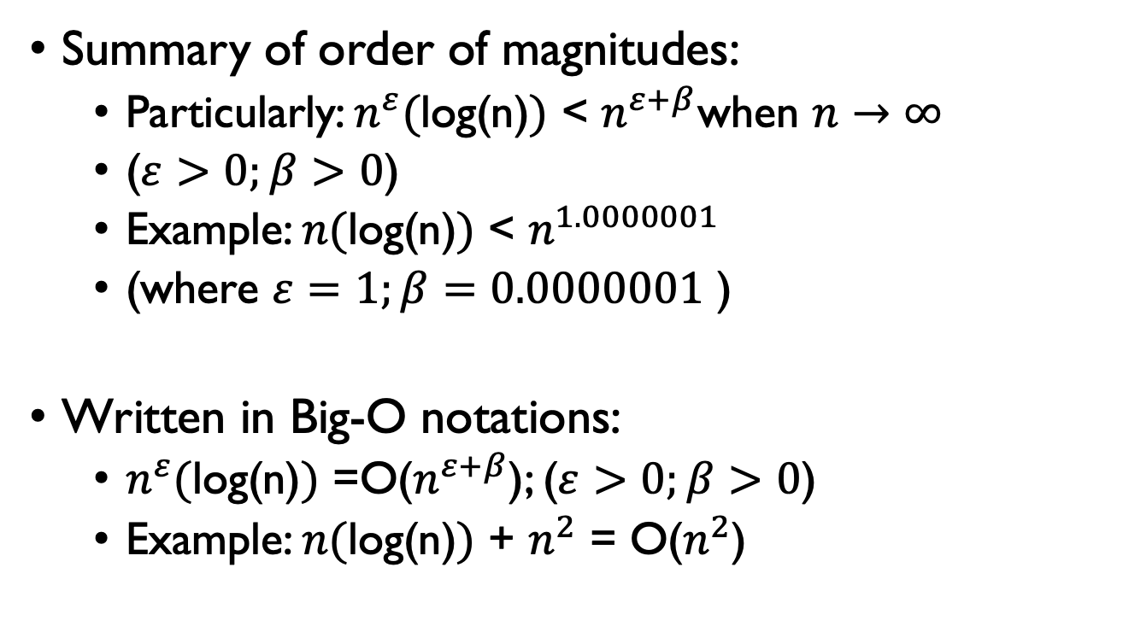
Common orders of magnitude
Summary of order of magnitudes:
Particularly: $n^{ε}(\text{log}\text{(}\text{n}\text{)})$ < $n^{ε+β}$when $n→∞$
($ε>0;β>0$)
Example: $n(\text{log}\text{(}\text{n}\text{)})$ < $n^{1.0000001}$
(where $ε=1;β=0.0000001$ )
Written in Big-O notations:
$n^{ε}(\text{log}\text{(}\text{n}\text{)})$ =O($n^{ε+β}$); ($ε>0;β>0$)
Example: $n(\text{log}\text{(}\text{n}\text{)})$ + $n^{2}$ = O($n^{2}$)

Slide 24
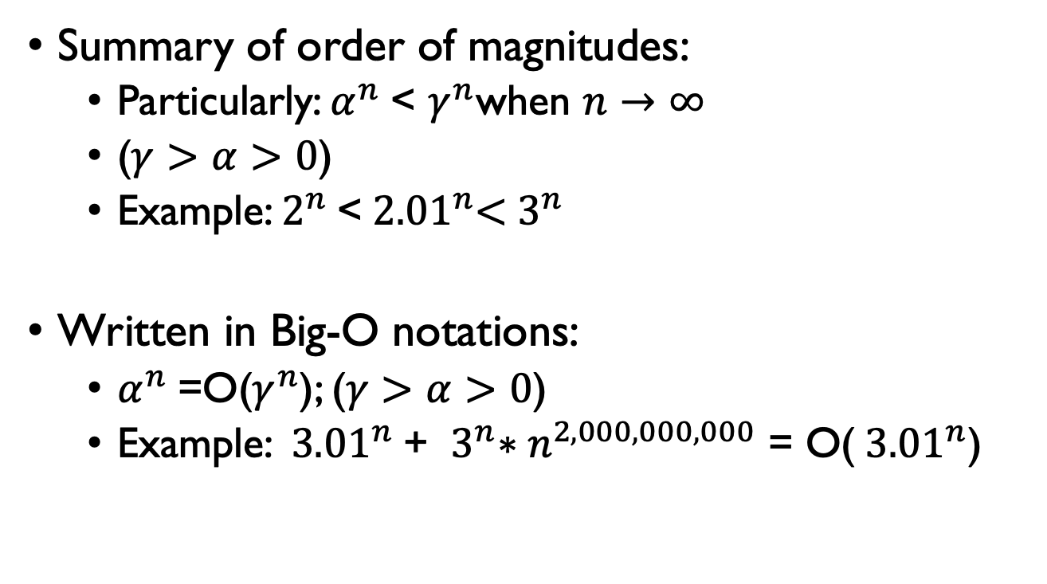
Common orders of magnitude
Summary of order of magnitudes:
Particularly: $α^{n}$< $γ^{n}$when $n→∞$
($γ>α>0$)
Example: $2^{n}$<${ 2.01}^{n}<{ 3}^{n}$
Written in Big-O notations:
$α^{n}$=O($γ^{n}$); ($γ>α>0$)
Example: ${ 3.01}^{n}$+ ${ 3}^{n}∗n^{2,000,000,000}$ = O(${ 3.01}^{n}$)

Slide 25
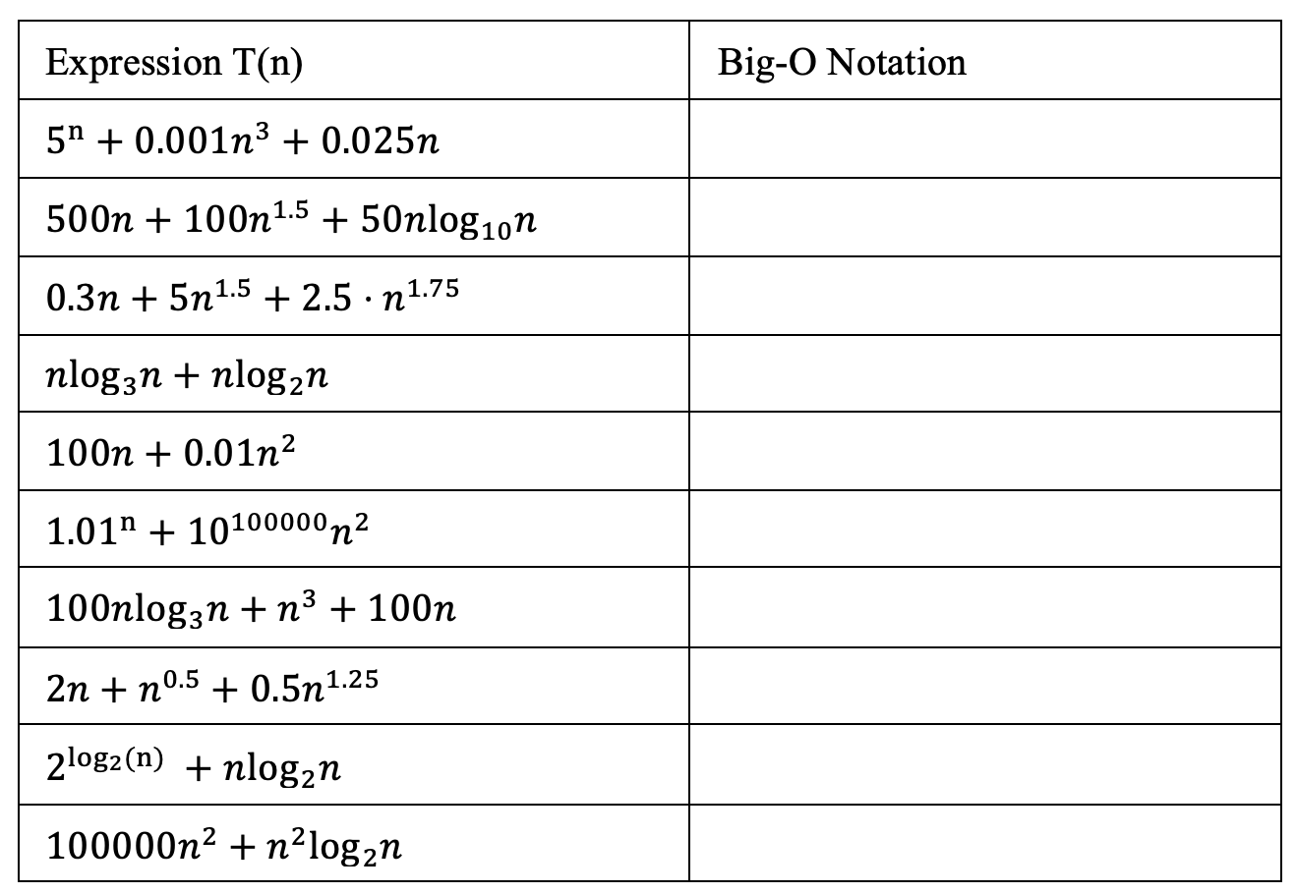
Practice 5-1
Give the Big-O notation of each time complexity function T(n) below.

Slide 26

Practice 5-2
def fibonacci(n):
if n <= 1:
return n
return fibonacci(n-1) + fibonacci(n-2)
fib(4)
/ \
fib(3) fib(2)
/ \ / \
fib(2) fib(1) fib(1) fib(0)
/ \
fib(1) fib(0)
Time Complexity: O($2^{n}$)

Slide 27

Proof of Big-O
Prove that $f(n)$ is $O( g(n) )$
Show there are
a constant $c>0$
and starting point $n_{0}>0$
such that $f\left(n\right)≤c×g(n)$ when $n≥n_{0}$

Slide 28
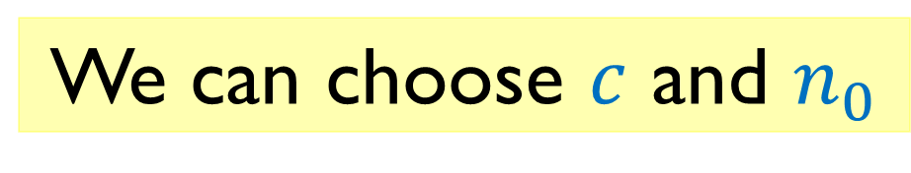

Proof of Big-O
Prove that $f(n)$ is $O( g(n) )$
Show there are
a constant $c>0$
and starting point $n_{0}>0$
such that $f\left(n\right)≤c×g(n)$ when $n≥n_{0}$
We can choose $c$ and $n_{0}$

Slide 29

Examples
Prove that $30n+8$ is $O(n)$
Show that there are $c>0$ and $n_{0}>0$:
$30n+8  c×n, n>n0$.

Slide 30
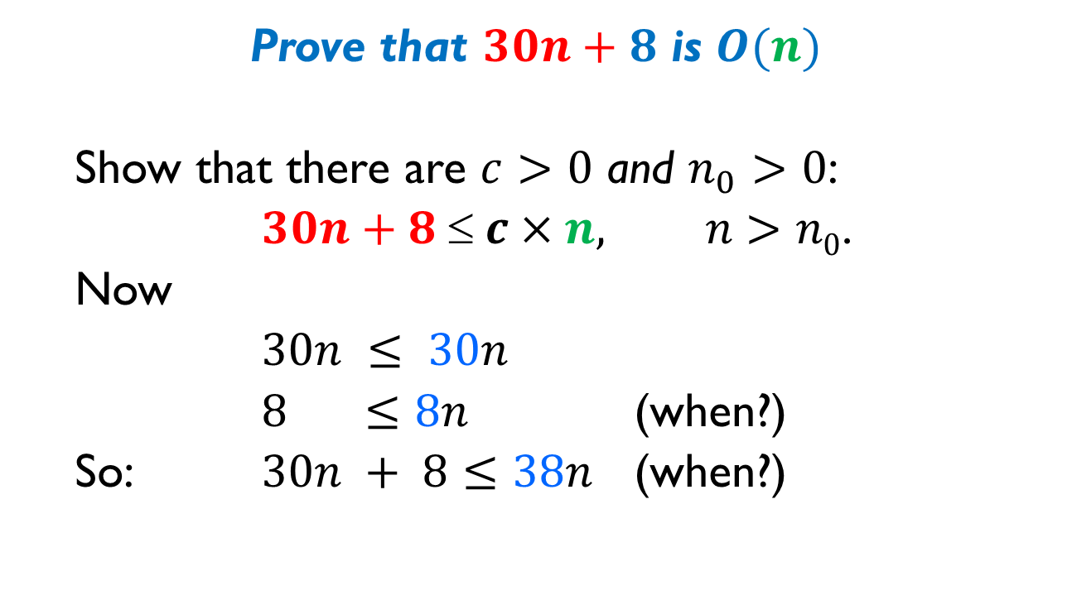
Examples
Prove that $30n+8$ is $O(n)$
Show that there are $c>0$ and $n_{0}>0$:
$30n+8  c×n, n>n0$.
Now
$30n ≤ 30n$
$8 ≤8n$ (when?)
So: $30n + 8≤38n$ (when?)

Slide 31

Examples
Prove that $30n+8$ is $O(n)$
Show that there are $c>0$ and $n_{0}>0$:
$30n+8  c×n, n>n0$.
Now
$30n ≤ 30n$
$8 ≤8n$ (when $n≥ 1$)
So: $30n + 8≤38n$ (when $n≥ 1$)

Slide 32
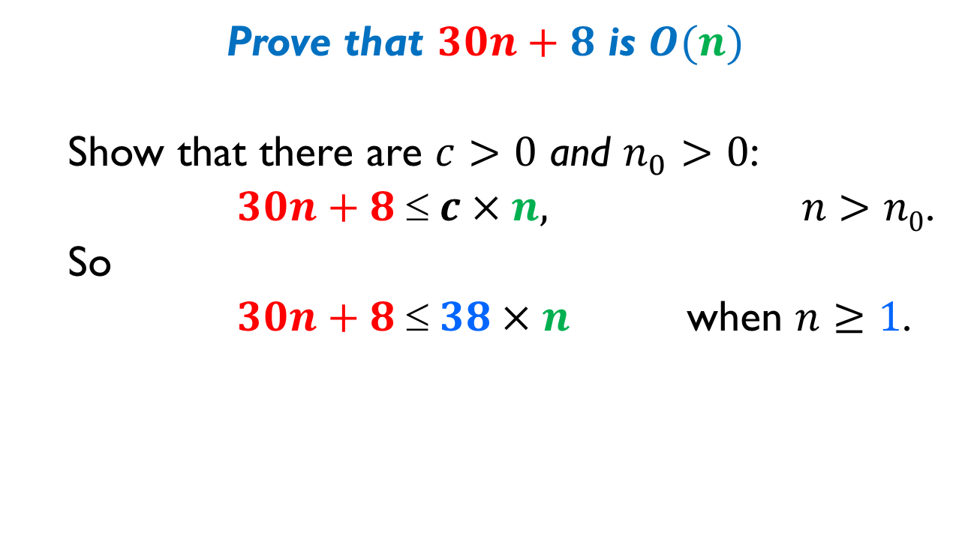
Examples
Prove that $30n+8$ is $O(n)$
Show that there are $c>0$ and $n_{0}>0$:
$30n+8  c×n, n>n0$.
So
$30n+8  38×n$ when $n≥1$.

Slide 33
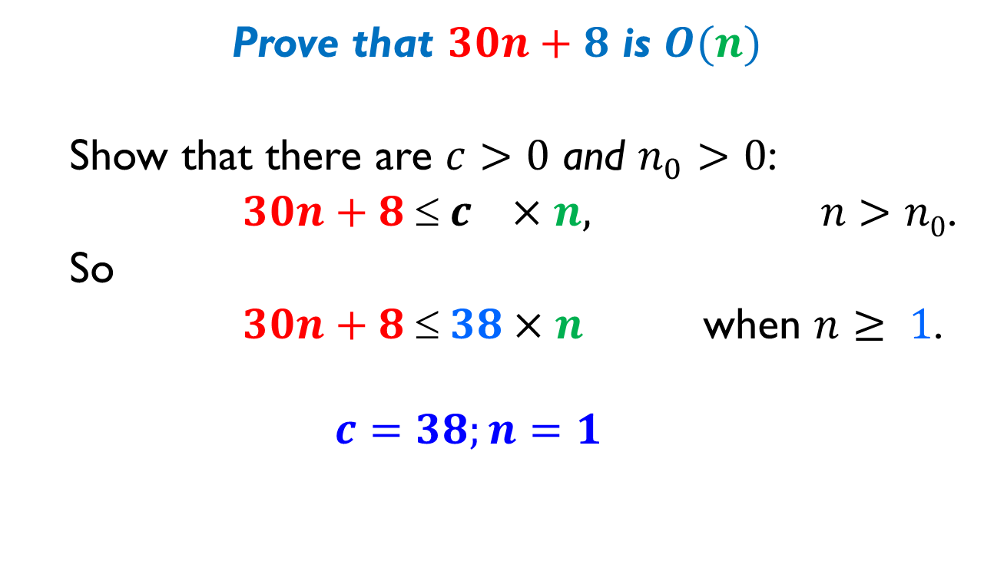
Examples
Prove that $30n+8$ is $O(n)$
Show that there are $c>0$ and $n_{0}>0$:
$30n+8  c ×n, n>n0$.
So
$30n+8  38×n$ when $n≥ 1$.
$$c=38;n=1$$

Slide 34
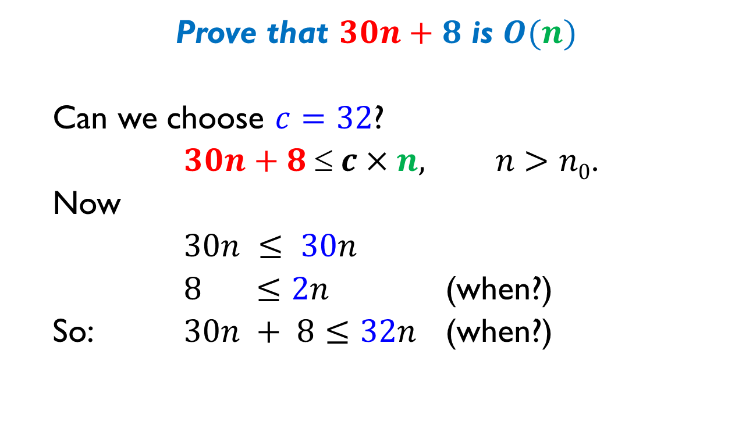
Examples
Prove that $30n+8$ is $O(n)$
Can we choose $c=32$?
$30n+8  c×n, n>n0$.
Now
$30n ≤ 30n$
$8 ≤2n$ (when?)
So: $30n + 8≤32n$ (when?)

Slide 35
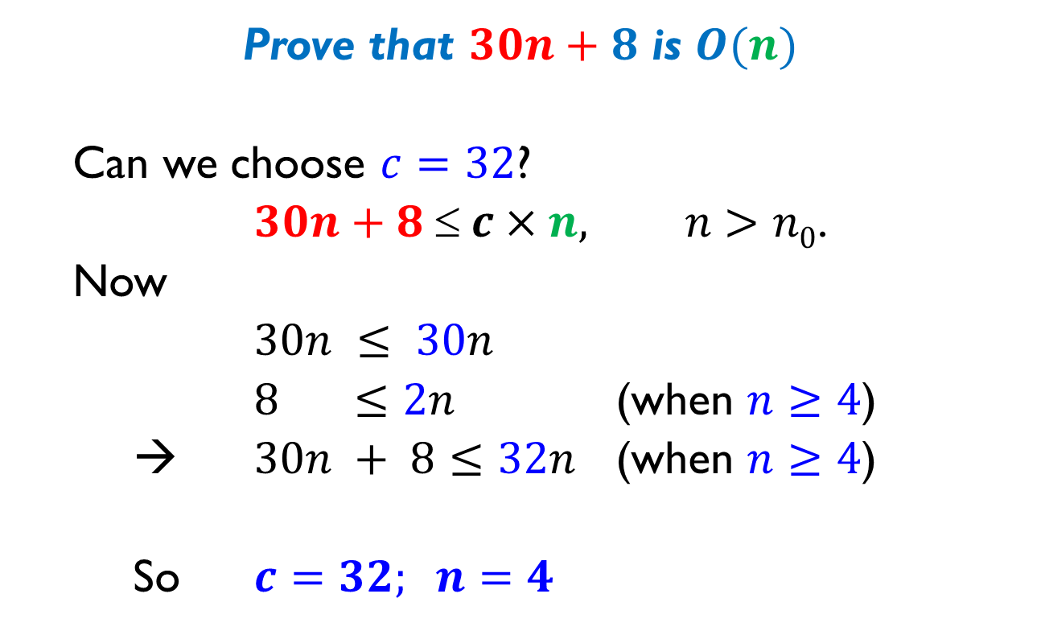
Examples
Prove that $30n+8$ is $O(n)$
Can we choose $c=32$?
$30n+8  c×n, n>n0$.
Now
$30n ≤ 30n$
$8 ≤2n$ (when $n≥4$)
→ $30n + 8≤32n$ (when $n≥4$)
So $c=32; n=4$

Slide 36

Examples
Prove that $30n^{2}−2n+7$ is $O(n^{2})$
Show there are $c>0$ and $n_{0}>0$:
$30n^{2}−2n+7≤c×n^{2}$ for $n≥n_{0}$.

Slide 37
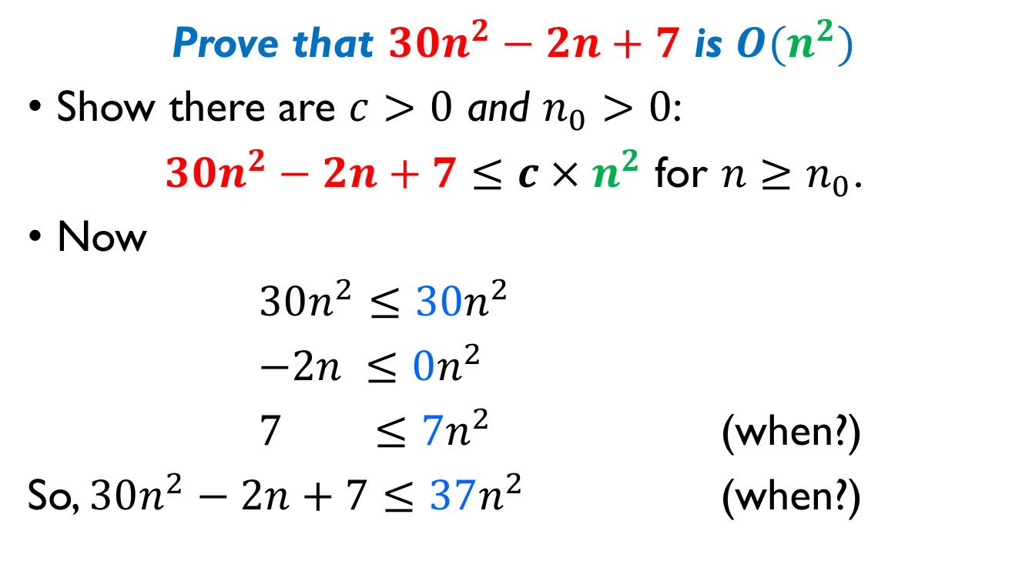
Examples
Prove that $30n^{2}−2n+7$ is $O(n^{2})$
Show there are $c>0$ and $n_{0}>0$:
$30n^{2}−2n+7≤c×n^{2}$ for $n≥n_{0}$.
Now
$30n^{2}≤30n^{2}$
$−2n ≤0n^{2}$
$7 ≤7n^{2}$ (when?)
So, $30n^{2}−2n+7≤37n^{2}$ (when?)

Slide 38
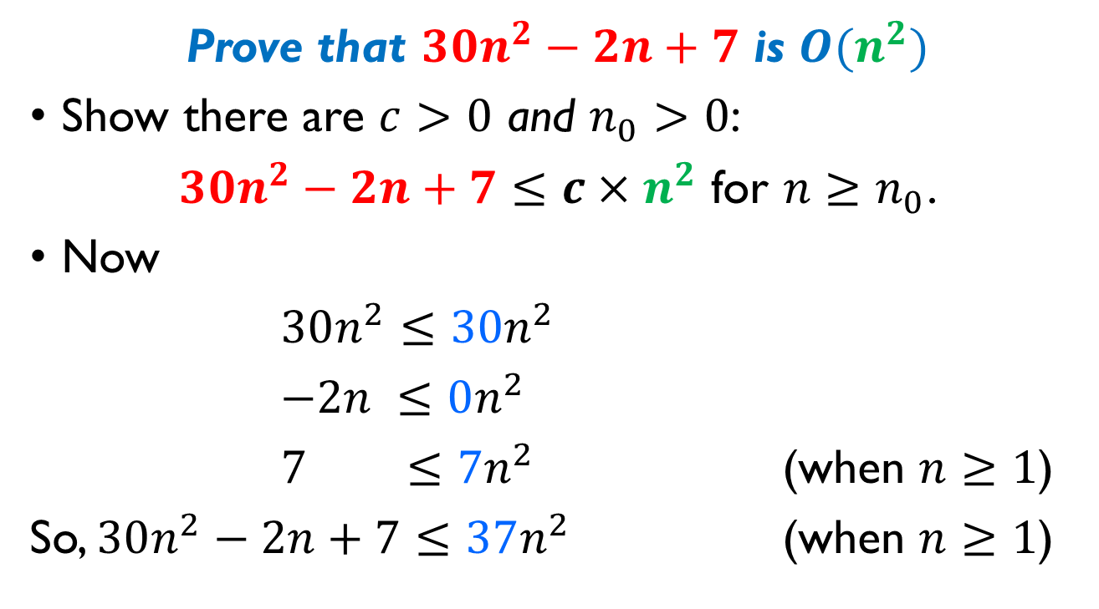
Examples
Prove that $30n^{2}−2n+7$ is $O(n^{2})$
Show there are $c>0$ and $n_{0}>0$:
$30n^{2}−2n+7≤c×n^{2}$ for $n≥n_{0}$.
Now
$30n^{2}≤30n^{2}$
$−2n ≤0n^{2}$
$7 ≤7n^{2}$ (when $n≥1$)
So, $30n^{2}−2n+7≤37n^{2}$ (when $n≥1$)

Slide 39
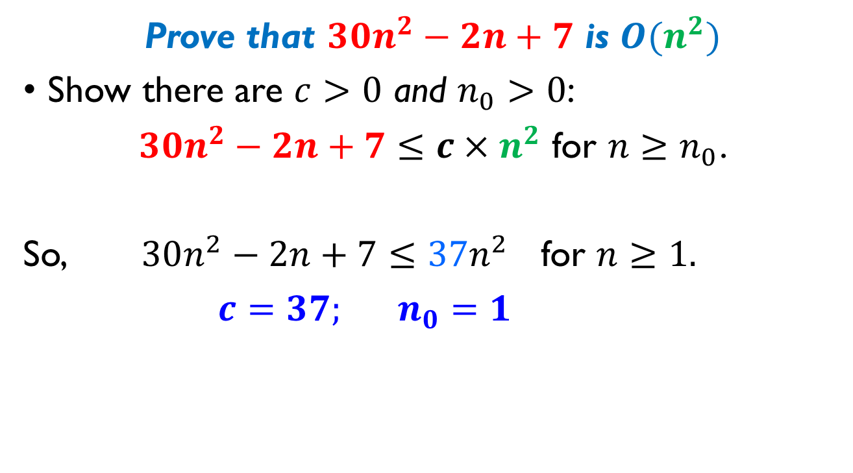
Examples
Prove that $30n^{2}−2n+7$ is $O(n^{2})$
Show there are $c>0$ and $n_{0}>0$:
$30n^{2}−2n+7≤c×n^{2}$ for $n≥n_{0}$.
So, $30n^{2}−2n+7≤37n^{2}$ for $n≥1.$
$c=37; n_{0}=1$

Slide 40

Examples
Is $30n^{2}−2n+7$ is $O(n)$?
Assume that this is true
It implies there $c>0$ and $n_{0}>0$ such that
$30n^{2}−2n+7≤c×n$ for $n≥n_{0}$.

Slide 41
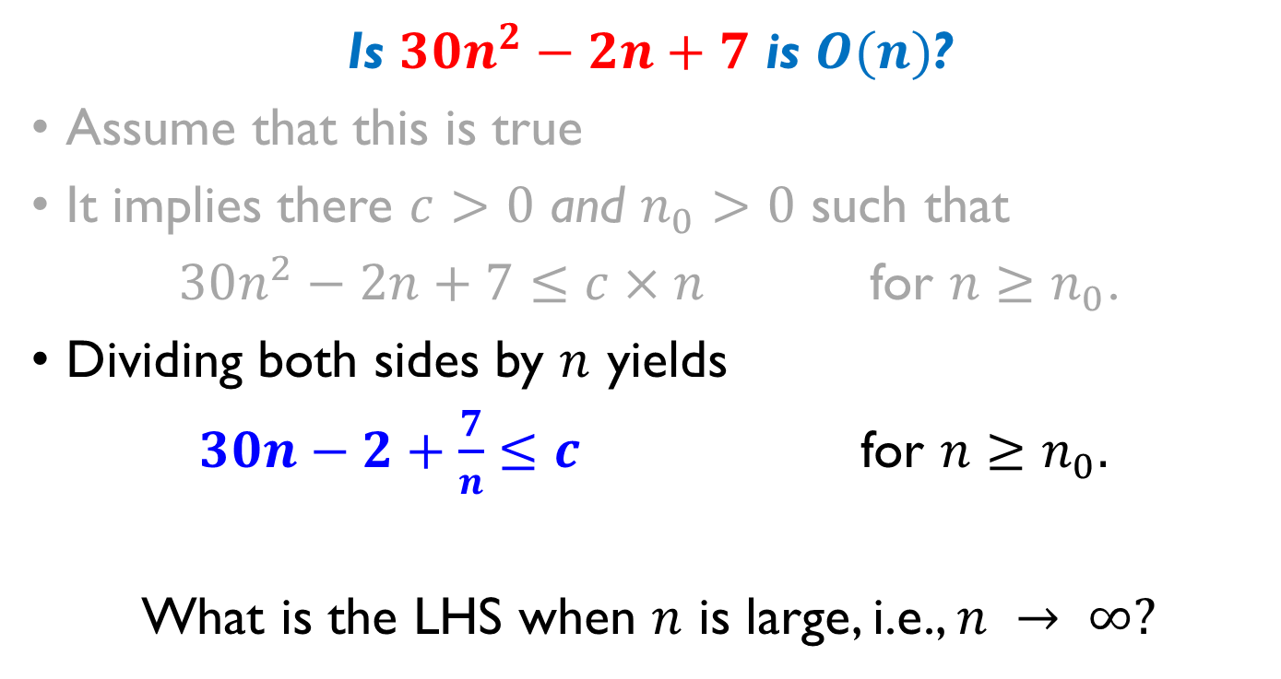
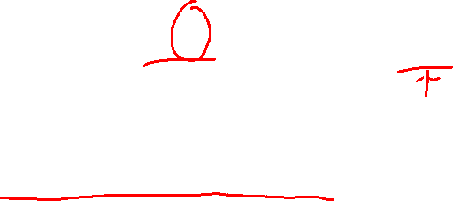
Examples
Is $30n^{2}−2n+7$ is $O(n)$?
Assume that this is true
It implies there $c>0$ and $n_{0}>0$ such that
$30n^{2}−2n+7≤c×n$ for $n≥n_{0}$.
Dividing both sides by $n$ yields
$30n−2+\frac{7}{n}≤c$ for $n≥n_{0}.$
What is the LHS when $n$ is large, i.e., $n → ∞?$

Slide 42

Examples
Is $30n^{2}−2n+7$ is $O(n)$?
$$30n−2+\frac{7}{n}≤c$$
What is the LHS when $n$ is large, i.e., $n → ∞?$
If is True

Slide 43





Examples
Is $30n^{2}−2n+7$ is $O(n)$?
$$30n−2+\frac{7}{n}≤c$$
If is True
$$n → ∞$$
$$∞$$
$$0$$
$$0$$

Slide 44
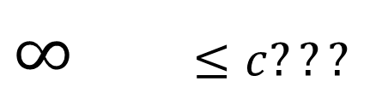

Examples
Is $30n^{2}−2n+7$ is $O(n)$?
$$30n−2+\frac{7}{n}≤c$$
If is True
$$n → ∞$$
$∞$ $≤c???$

Slide 45
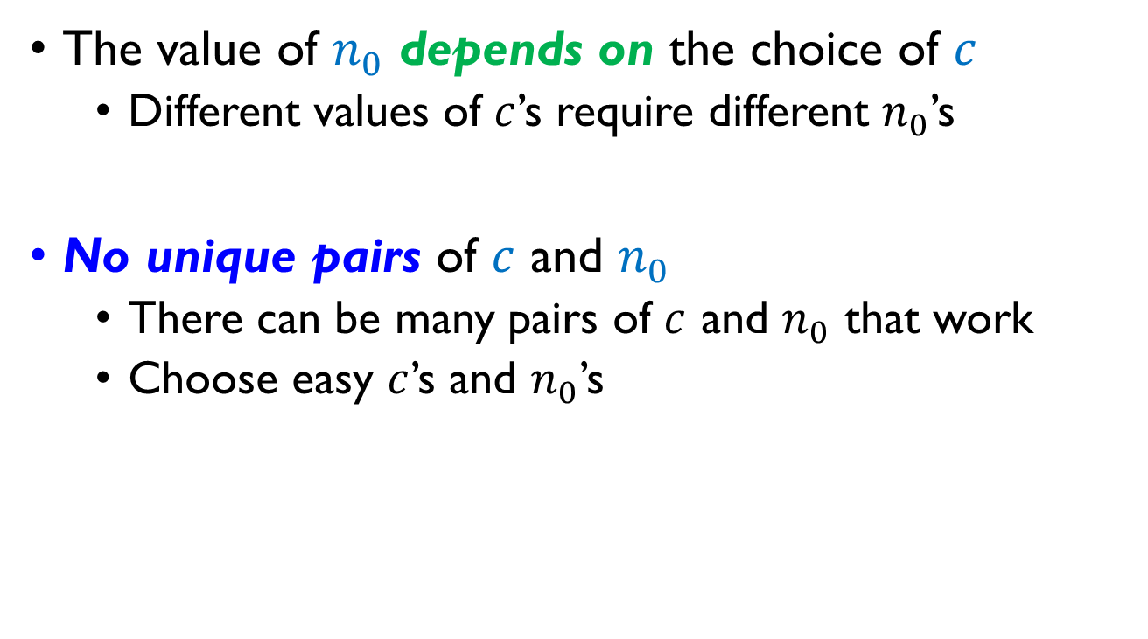
Proof of Big-O – Notes:
The value of $n_{0}$ depends on the choice of $c$
Different values of $c$’s require different $n_{0}$’s
No unique pairs of $c$ and $n_{0}$
There can be many pairs of $c$ and $n_{0}$ that work
Choose easy $c$’s and $n_{0}$’s

Slide 46

Practice 5-2
Determine and prove the Big-O estimates for the following function $f(n)$
$f\left(n\right)=3n^{2}+7n+2$
$f\left(n\right)=5n^{4}+4n^{3}−3n^{2}+1$

Slide 47

Practice 5-2
Determine and prove the Big-O estimates for the following function $f(n)$
$f\left(n\right)=3n^{2}+7n+2$ $O\left(n^{2}\right)$
$f\left(n\right)=5n^{4}+4n^{3}−3n^{2}+1$ $O\left(n^{4}\right)$

Slide 48

More Examples
Do the following statements hold?
$f\left(n\right)=2n^{2}−5n+3$ is $O\left(n\right)$
$f\left(n\right)=2n^{2}−7n+1$ is $O(n\sqrt{n})$

Slide 49
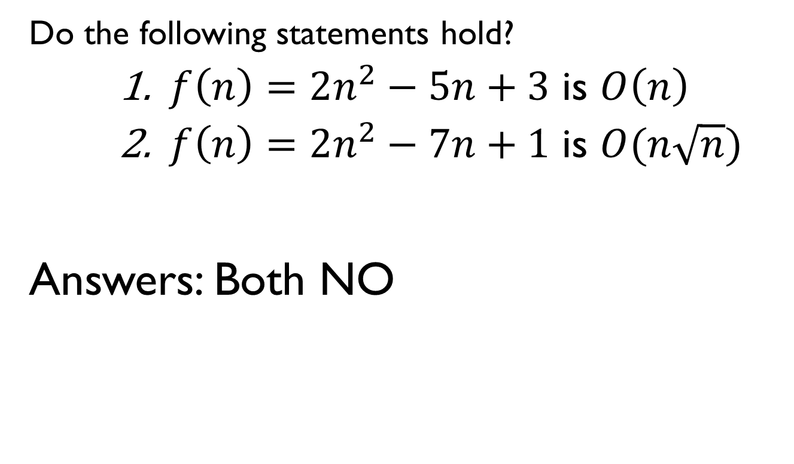
More Examples
Do the following statements hold?
$f\left(n\right)=2n^{2}−5n+3$ is $O\left(n\right)$
$f\left(n\right)=2n^{2}−7n+1$ is $O(n\sqrt{n})$
Answers: Both NO

Slide 50
Big-O example, graphically
Note 30n+8 isn’t less than n anywhere (n>0).
It isn’t even less than 31n everywhere.
But it is less than 31n everywhere to the right of n=8.
cn = 31n
30n+8
Value of function →
30n+8 ∈O(n)
n
n>n₀=8 →
Increasing n →

Slide 51
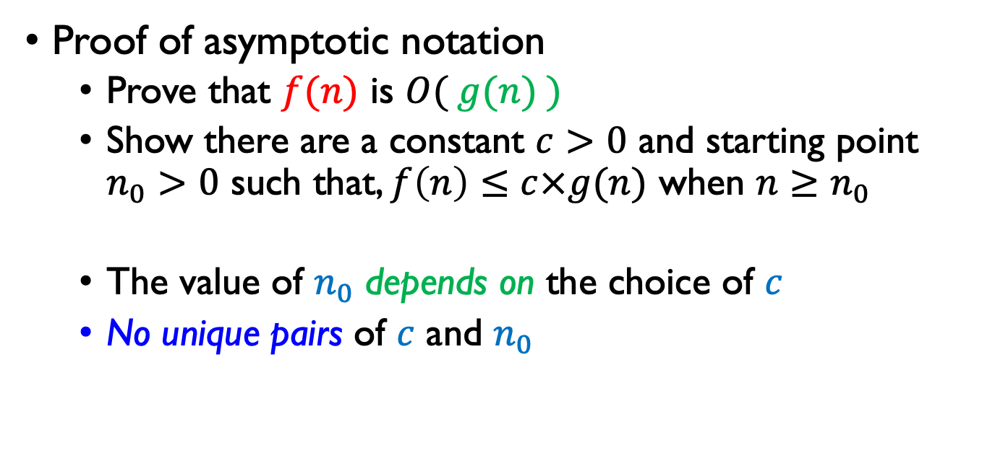
Summary
Proof of asymptotic notation
Prove that $f(n)$ is $O( g(n) )$
Show there are a constant $c>0$ and starting point $n_{0}>0$ such that, $f\left(n\right)≤c×g(n)$ when $n≥n_{0}$
The value of $n_{0}$ depends on the choice of $c$
No unique pairs of $c$ and $n_{0}$

